Slide 1
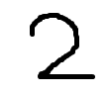
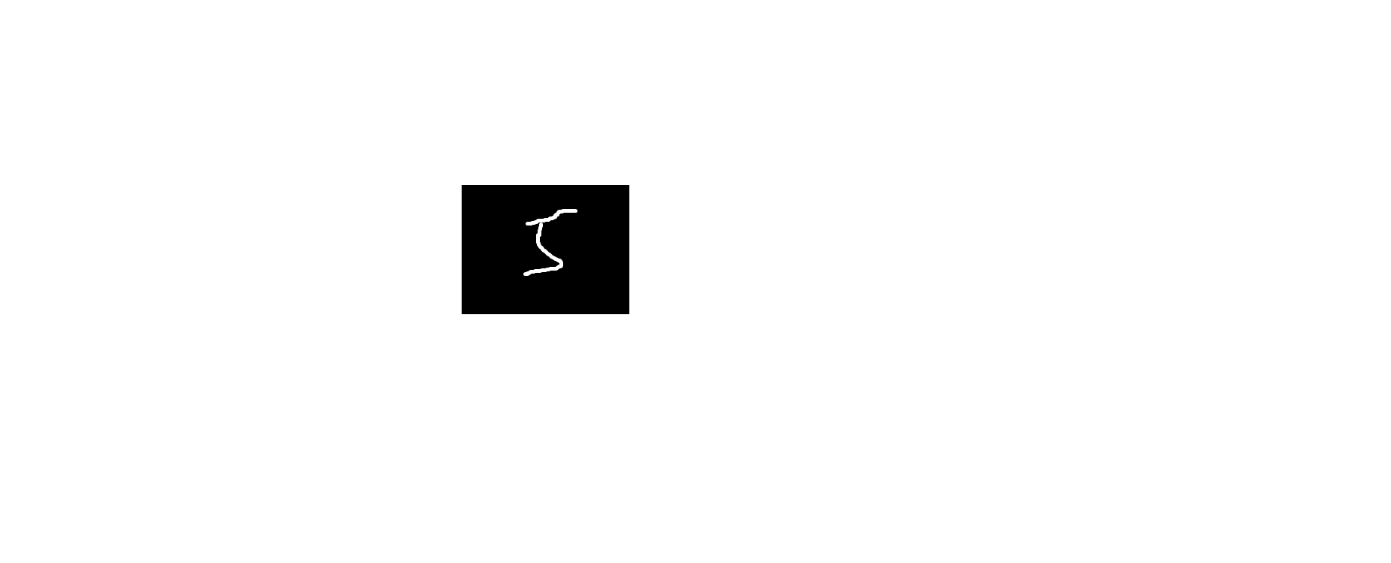
卷积神经网络结构
输入层
卷积层
全连接层
输出层
（1）
1
2
3
卷积
池化
卷积
池化
全连接
全连接
输出
C₁
S₁
C₂
S₂
Input
1×28×28
Feature maps
4×24×24
Feature maps
4×12×12
Feature maps
8×8×8
Feature maps
8×4×4
n₁
n₂
Output
0
（2）
1
..............
..............
8
9
5×5
Convolution
2×2
Subsampling
5×5
Convolution
2×2
Subsampling
Fully
Connected
Fully
Connected
Feature Extraction
Classification

Slide 2
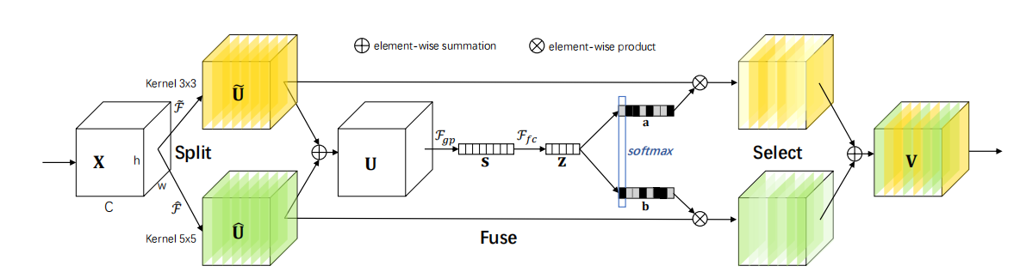
https://arxiv.org/abs/1903.06586
Selective Kernel Convolution
Original image
element-wise summation
element-wise product
Kernel 3×3
~
~
𝓕
𝓕
𝓕
_{gp}
fc
softmax
Split
Select
^
𝓕
^
Fuse
Kernel 5×5

Slide 3
卷积
1
2
1
0
2
3
0
1
1
2
0
1
3
0
2
1
2
2
（1）
卷积核3×3
0
1
1
1
0
0
1
0
0
5
4
5
5
1
2
3
2
0
2
0
0
0
·
·
·
·
0
0
1
0
1
0
0
0
2
·
·
·
·
输入图像6×6
·
·
·
·
特征图4×4
1
1
1
0
0
1
1
1
1
0
convolution
1
0
1
4
0
0
1
1
1
0
1
0
=
（2）
0
0
1
1
0
1
0
1
0
1
1
0
0
filter
feature map
5×5 image

Slide 4
卷积
1
2
1
0
2
3
0
1
1
2
0
1
3
0
2
1
2
2
0
1
1
1
0
0
1
0
0
1
2
3
2
0
2
0
0
0
0
0
1
0
1
0
0
0
2
输入图像6×6

Slide 5
CONV
11x11.
stride=4，
96 kernels
Overlapping
Max POOL
3x3,
stride=2
CONV
5x5,pad=2
256 kernels
Overlapping
Max POOL
3x3,
stride=2
CONV
3x3,pad=1
374 kernels
CONV
3x3,pad=1
384 kernels
CONV
3x3,pad=1
256 kernels
Overlapping
Max POOL
3x3,
stride=2
FC
FC

Slide 6
3
CONV
11x11，
stride=4，
96 kernels
Overlapping
Max POOL
3x3,
stride=2
CONV
5x5,pad=2
256 kernels
Overlapping
Max POOL
3x3,
stride=2
CONV
3x3,pad=1
384 kernels
227
11
55
256
96
27
96
27
256
11
13
55
27
27
13
227
CONV
3x3,pad=1
384 kernels
CONV
3x3,pad=1
256 kernels
Overlapping
Max POOL
3x3,
stride=2
FC
FC
384
384
256
256
13
6
13
13
6
1000
softmax
13
13
13
4096
4096

Slide 8
CONV
3x3，
stride=1，
32 kernels
Max POOL
2x2,
stride=2
CONV
3x3，
stride=1，
64 kernels
3
SENet
3
32
3
32
32
32
16
32
16
64
32
32
32
32
16
16
16
16
Max POOL
2x2,
stride=2
CONV
3x3,
128 kernels
Max POOL
2x2,
stride=2
64
64
128
FC
FC
16
8
128
16
8
8
4
10
softmax
8
8
8
4
2048
512

Slide 9
CONV
3x3，
stride=1，
96 kernels
Max POOL
2x2,
stride=2
CONV
3x3,
256 kernels
Max POOL
2x2,
stride=2
CONV
3x3,
384 kernels
3
3
32
3
32
256
SENet
96
16
96
SENet
256
16
8
32
32
16
16
8
CONV
3x3,
384 kernels
CONV
3x3,
256 kernels
Max POOL
2x2,
stride=2
SENet
FC
FC
384
384
256
256
8
4
10
softmax
8
8
8
4
8
8
4096
512

Slide 10
池化
平均池化
步长为2，大小为2×2
2
5
4
4
3
6
2
3
9
7
3
2
（1）
4
1
0
0
最大池化
步长为2，大小为2×2
5
9
3
4
0
8
4
8
Pooling Indices
（池化索引）
2
5
7
3
0
7
0
0
4
1
9
3
0
0
6
0
（2）
6
8
3
6
0
5
0
0
5
9
7
6
3
2
1
5
0
0
1
2
8
5
5
2
Max Pooling
（最大池化）
Unpooling
（反池化）

Slide 11
卷积/转置卷积
卷积, k = 3, s = 1, p = 0
转置卷积, k = 3, s = 2, p = 0

Slide 12
Dropout 网络模型
Before Dropout
After Dropout

Slide 13
全连接层结构
输入层
隐藏层
输出层
（1）
...
...
...
（2）
...
Input Layer
Fully Connected Layer
Output Layer

Slide 14
MLP 多层感知器
Softmax
Softmax
Output Layer
Σ
Σ
Σ
1
Hidden Layer
（1）
Σ
Σ
Σ
Σ
1
Input Layer
x₁
x₂
Softmax
w₁
w₂
（2）
...
...
...
Input Layer
Hidden Layer
Output Layer

Slide 15
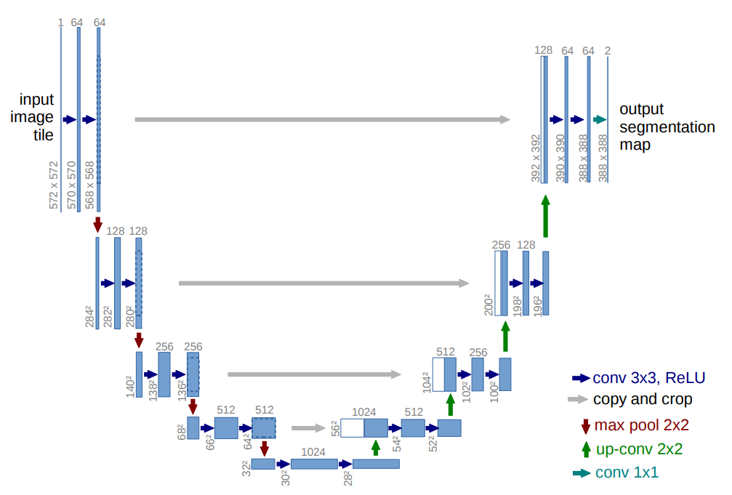
U-Net
https://arxiv.org/abs/1505.04597
Original image
1
64
64
128
64
64
1
input
image
output
128
128
256
128
256
256
512
256
Conv 3×3, ReLU
copy and crop
512
512
1024
512
Max Pooling 2×2
Up Conv 2×2
1024
Conv 1×1

Slide 16
RNN
Unfold

Slide 17
空洞卷积
Original image

Slide 18
可分离卷积
3 Channel Input
Filters×3
Maps×3
NxN
（1）深度卷积
NxN
Maps×3
Filters×4
Maps×4
NxN
（2）逐点卷积
NxN

Slide 19
决策树(Decision Tree)
DataSet
Tree-1
Tree-2
Tree-3
Majority Voting / Averaging
Final Result

Slide 20
支持向量机(Support Vector Machine)

Slide 21
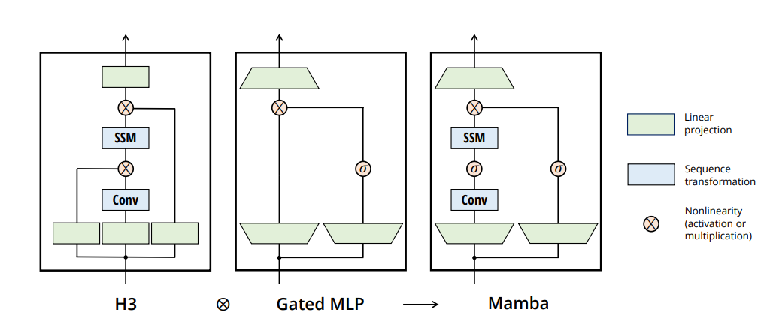
Mamba
https://arxiv.org/pdf/2312.00752
Original image
Linear
Projection
SSM
SSM
Sequence
transformation
Conv
Conv
Nonlinearity
(activation or
multiplication)
H3
Gated MLP
Mamba

Slide 22
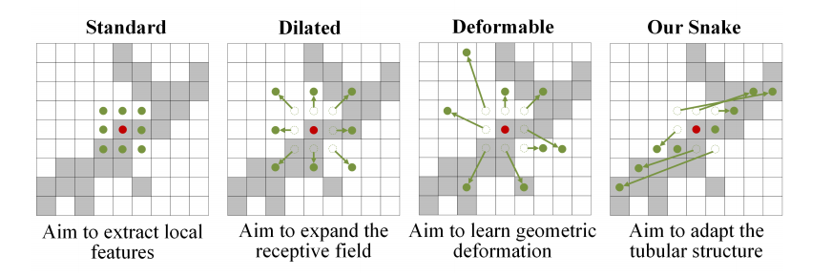
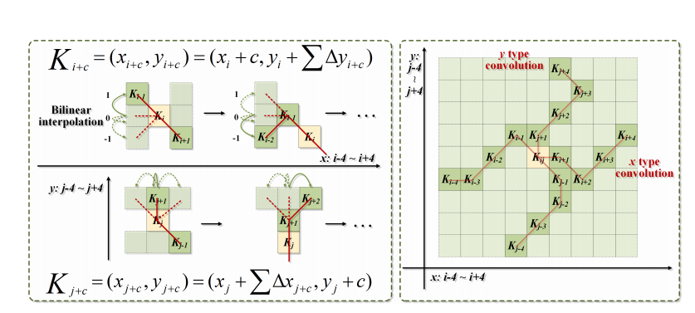
动态蛇形卷积
https://arxiv.org/abs/2307.08388
Original image
Strandard
Dilated
Deformable
Snake
y type
convolution
Bilinear
interpolation
...
~
~
x type
convolution
...
~
~

Slide 23
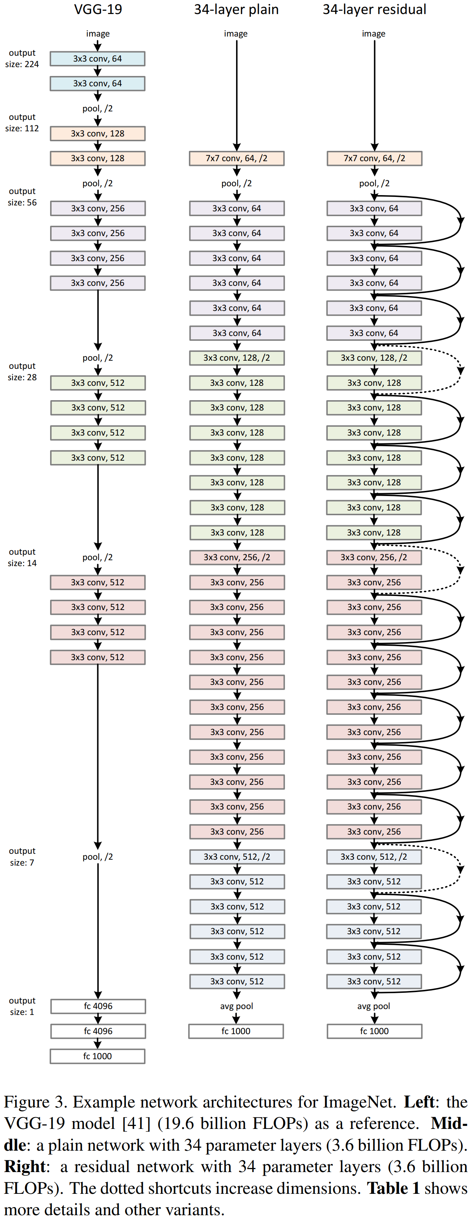

Original image
VGG-19
34-layer
34-layer
image
image
image
VGG-19/Plain Network/Residual Network
3×3 conv, 64
3×3 conv, 64
pool, /2
3×3 conv, 128
3×3 conv, 128
7×7 conv, 64, /2
7×7 conv, 64, /2
pool, /2
pool, /2
pool, /2
3×3 conv, 256
3×3 conv, 64
3×3 conv, 64
3×3 conv, 256
3×3 conv, 64
3×3 conv, 64
https://arxiv.org/abs/1512.03385
3×3 conv, 256
3×3 conv, 64
3×3 conv, 64
3×3 conv, 256
3×3 conv, 64
3×3 conv, 64
3×3 conv, 64
3×3 conv, 64
3×3 conv, 64
3×3 conv, 64
pool, /2
3×3 conv, 128, /2
3×3 conv, 128, /2
3×3 conv, 512
3×3 conv, 128
3×3 conv, 128
3×3 conv, 512
3×3 conv, 128
3×3 conv, 128
3×3 conv, 512
3×3 conv, 128
3×3 conv, 128
3×3 conv, 512
3×3 conv, 128
3×3 conv, 128
3×3 conv, 128
3×3 conv, 128
3×3 conv, 128
3×3 conv, 128
3×3 conv, 128
3×3 conv, 128
pool, /2
3×3 conv, 256, /2
3×3 conv, 256, /2
3×3 conv, 512
3×3 conv, 256
3×3 conv, 256
3×3 conv, 512
3×3 conv, 256
3×3 conv, 256
3×3 conv, 512
3×3 conv, 256
3×3 conv, 256
3×3 conv, 512
3×3 conv, 256
3×3 conv, 256
3×3 conv, 256
3×3 conv, 256
3×3 conv, 256
3×3 conv, 256
3×3 conv, 256
3×3 conv, 256
3×3 conv, 256
3×3 conv, 256
3×3 conv, 256
3×3 conv, 256
3×3 conv, 256
3×3 conv, 256
3×3 conv, 256
3×3 conv, 256
pool, /2
3×3 conv, 512, /2
3×3 conv, 512, /2
3×3 conv, 512
3×3 conv, 512
3×3 conv, 512
3×3 conv, 512
3×3 conv, 512
3×3 conv, 512
3×3 conv, 512
3×3 conv, 512
3×3 conv, 512
3×3 conv, 512
fc 4096
avg pool
avg pool
fc 4096
fc 1000
fc 1000
fc 1000

Slide 24
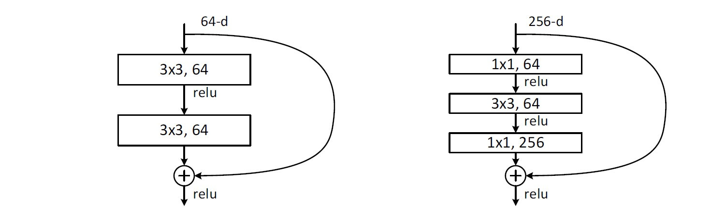
残差块(Residual Block)
https://arxiv.org/abs/1512.03385
Original image
64-d
256-d
3×3, 64
1×1, 64
relu
relu
3×3, 64
3×3, 64
relu
1×1, 256
relu
relu

Slide 25
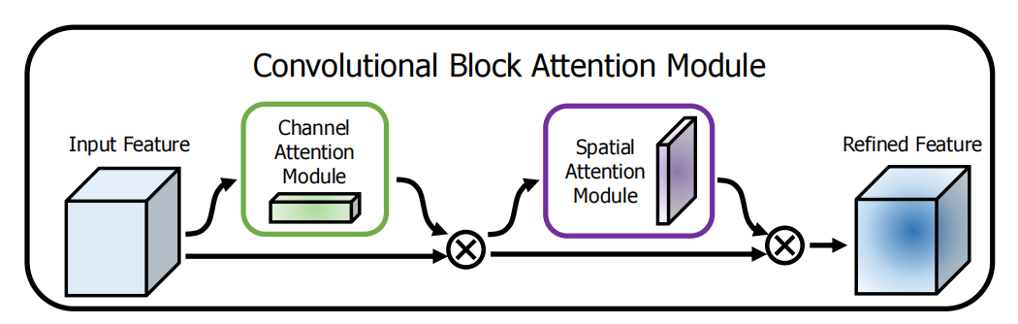
CBAM
https://arxiv.org/abs/1807.06521
Original image
Input Feature
Channel
Attention Module
Refined Feature
Spatial
Attention Module

Slide 26
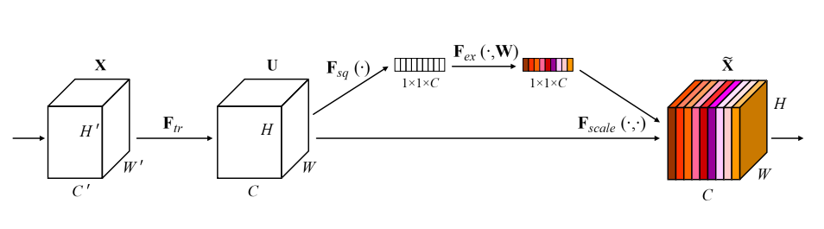
Squeeze-and-Excitation block
https://arxiv.org/abs/1709.01507
Original image
1×1×C
1×1×C
’
’
’

Slide 27
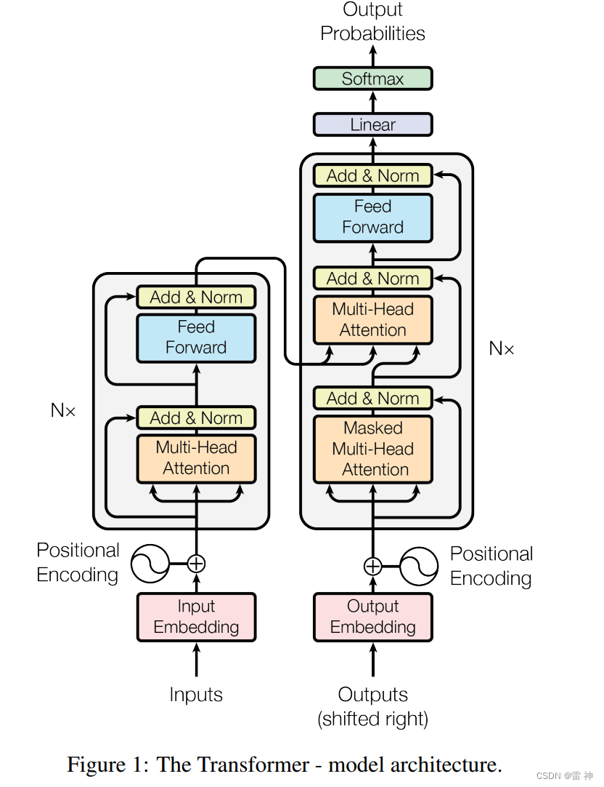
Transformer
https://proceedings.neurips.cc/paper/2017/file/3f5ee243547dee91fbd053c1c4a845aa-Paper.pdf
Original image
Output
Probablities
Softmax
Linear
Add & Norm
Feed
Forward
Add & Norm
Add & Norm
Multi-Head
Attention
Feed
Forward
N×
Add & Norm
N×
Add & Norm
Masked
Multi-Head
Attention
Multi-Head
Attention
Positional
Encoding
Positional
Encoding
Input
Embedding
Output
Embedding
Inputs
Outputs
(Shifted right)

Slide 28
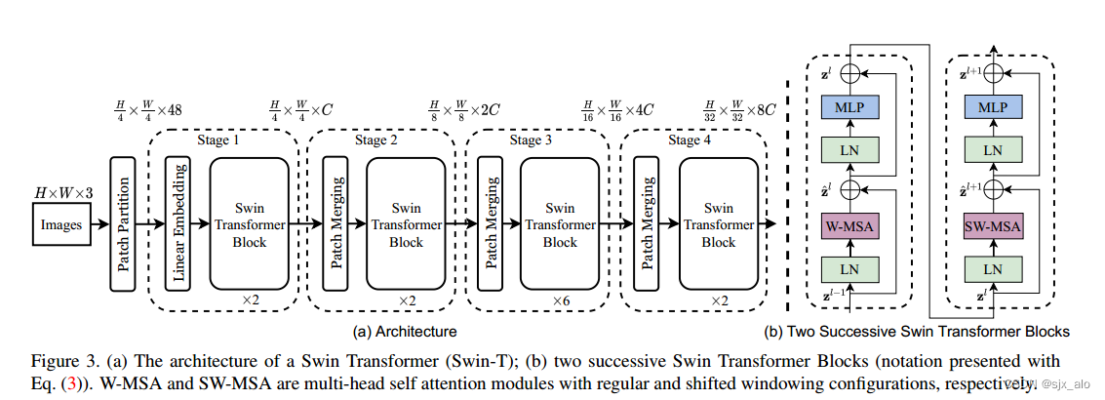
Swin Transformer
https://arxiv.org/abs/2103.14030
Original image
MLP
MLP
Stage 1
Stage 2
Stage 3
Stage 4
LN
LN
Swin
Transformer
Block
Swin
Transformer
Block
Swin
Transformer
Block
Swin
Transformer
Block
W-MSA
W-MSA
Linear Embedding
Images
Patch Partition
Patch Merging
Patch Merging
Patch Merging
LN
LN
×2
×2
×6
×2

Slide 29
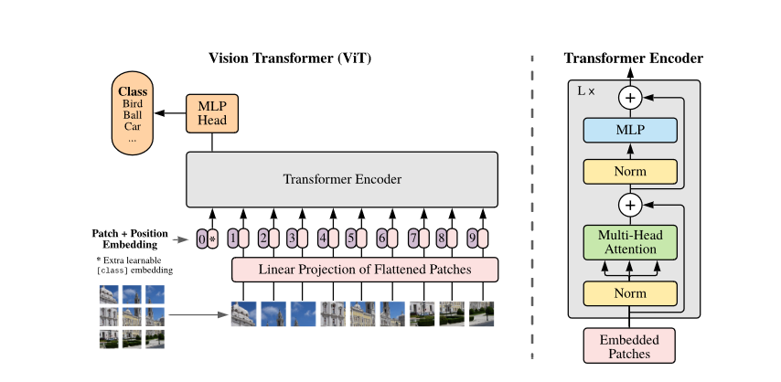
Visual Transformer(ViT)
https://arxiv.org/pdf/2010.11929.pdf
Original image
Vision Transformer (ViT)
Transformer Encoder
Class
Bird
Ball
Car
...
MLP
Head
MLP
Transformer Encoder
Norm
Patch + Position
Embedding
Multi-Head
Attention
0
*
1
2
3
4
5
6
7
8
9
* Extra learnable
[class] embedding
Linear Projection of Flattened Patches
Norm
Embedded
Patches

Slide 30
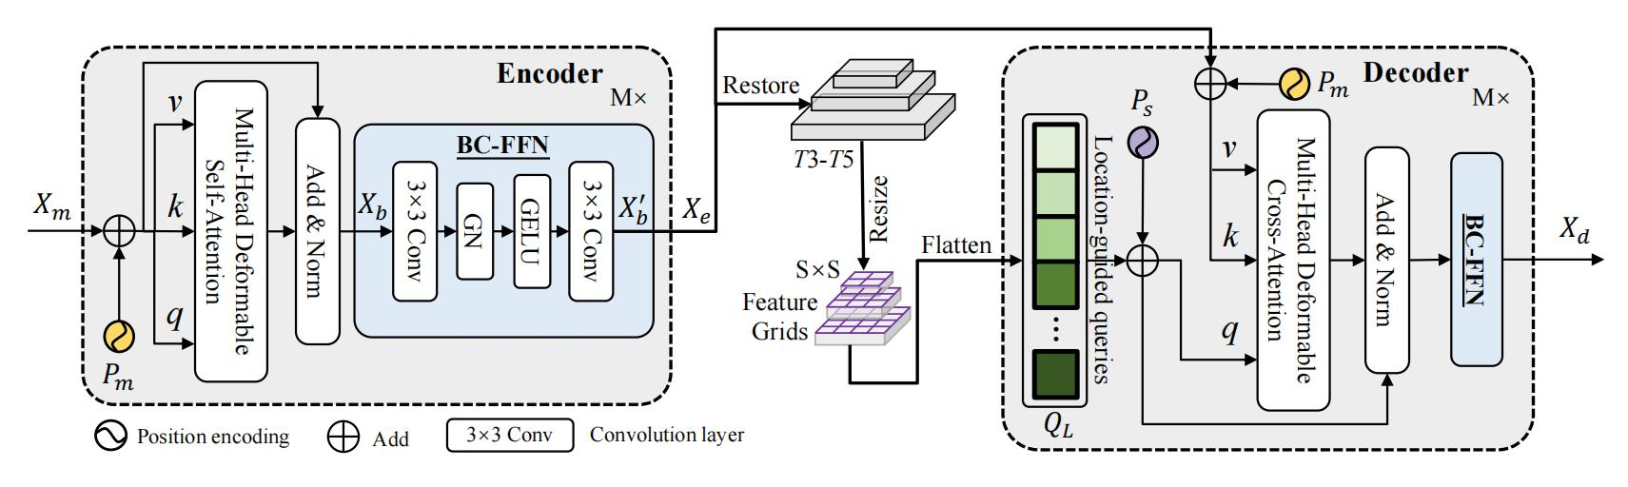
location-sensing transformer (LST)
https://arxiv.org/abs/2207.02255
Original image
Encoder
Restore
Decoder
M×
M×
BC-FFN
T3-T5
v
Multi-Head Deformable
Self-Attention
Resize
3×3 Conv
3×3 Conv
Add & Norm
GN
GELU
Flatten
S×S
Location-guided queries
Multi-Head Deformable
Cross-Attention
Add & Norm
BC-FFN
Feature Grids
...
Position encoding
Add
3×3 Conv
Convolution layer

Slide 31
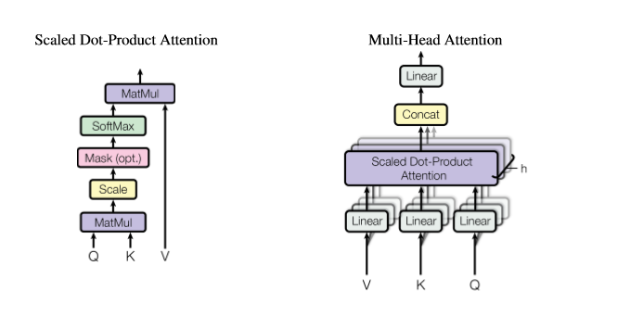
Scaled Dot-Product Attention/
Multi-Head Attention(多头注意力)
https://proceedings.neurips.cc/paper/2017/file/3f5ee243547dee91fbd053c1c4a845aa-Paper.pdf
Original image
Scaled Dot-Product Attention
Multi-Head Attention
MatMul
Linear
SoftMax
Concat
Mask (opt.)
Scaled Dot-Product
Attention
Scale
MatMul
Linear
Linear
Linear
Q
K
V

Slide 32
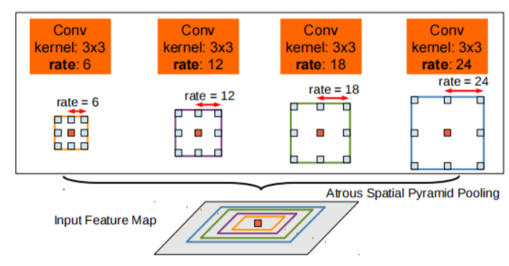
ASPP模块
https://arxiv.org/abs/1606.00915
Original image
Conv
Kernel: 3×3
rate: 6
Conv
Kernel: 3×3
rate: 12
Conv
Kernel: 3×3
rate: 18
Conv
Kernel: 3×3
rate: 24
rate = 18
rate = 24
rate = 6
rate = 12
Atrous Spatial Pyramid Pooling
Input Feature Map

Slide 33
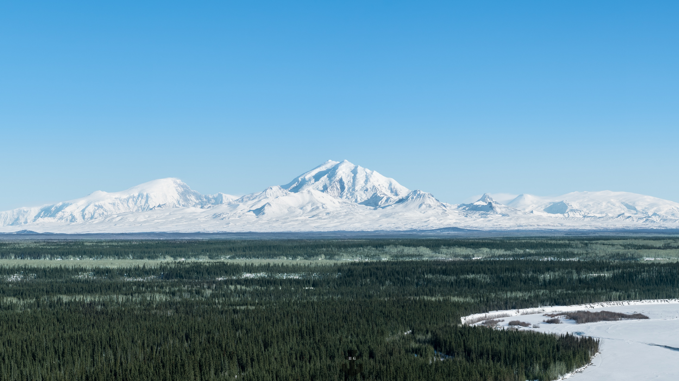
predict
predict
predict
2× up
1×1 conv
+

Slide 34
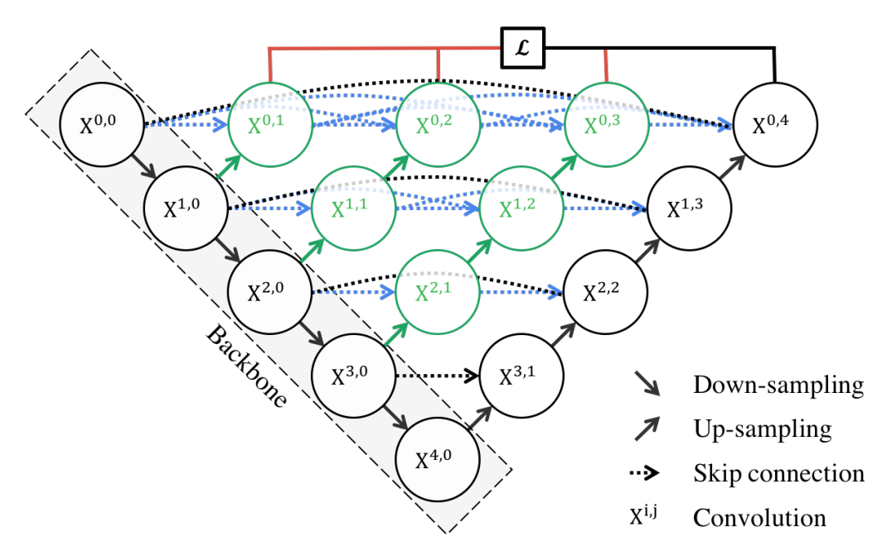
UNet++整体架构
https://arxiv.org/abs/1912.05074
Original image
𝓛
Backbone
Down-sampling
Up-sampling
Skip connection
Convolution

Slide 35
Yolov5s
Focus
CBL
CSP1_1
CBL
CSP1_3
CBL
CSP1_3
CBL
SPP
CSP2_1
CBL
上采样
Concat
CSP2_1
CBL
上采样
Concat
CSP2_1
conv
CBL
=
Conv
BN
Leaky
relu
CBL
Concat
CSP2_1
conv
Res
unit
=
CBL
CBL
add
CBL
CSP2_1
conv
Concat
CSP1_X
=
CBL
Res
unit
Conv
Concat
BN
Leaky
relu
CBL
Conv
slice
Maxpool
=
slice
=
CSP2_X
CBL
CBL
Conv
Focus
=
Concat
CBL
SPP
CBL
Maxpool
Concat
CBL
Leaky
relu
slice
Concat
BN
CBL
slice
Maxpool
Conv

Slide 36
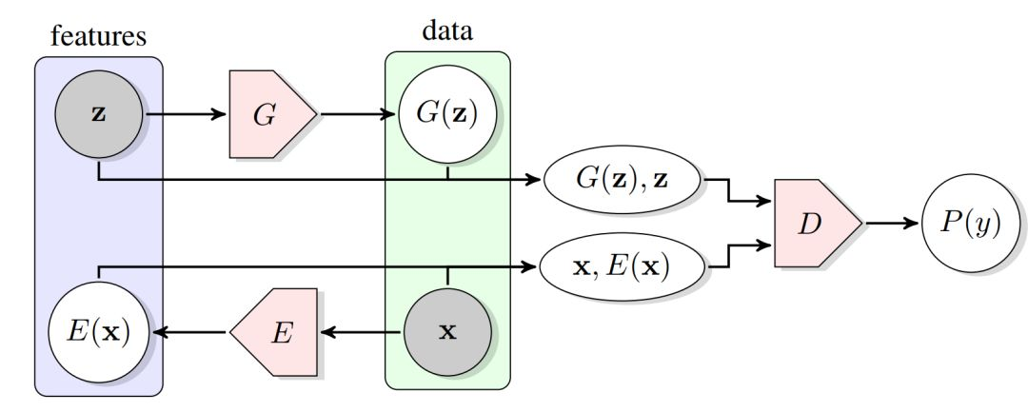
BiGAN 双向生成对抗网络
https://arxiv.org/pdf/1605.09782
Original image
features
data

Slide 37
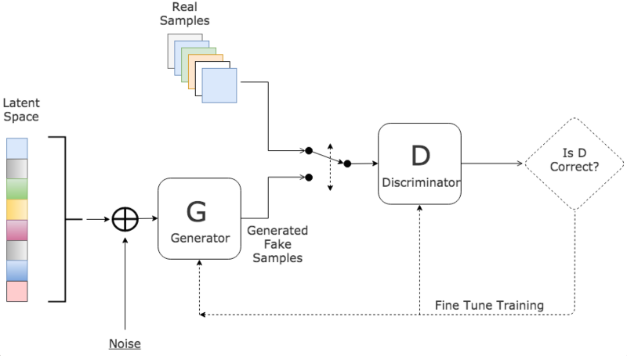
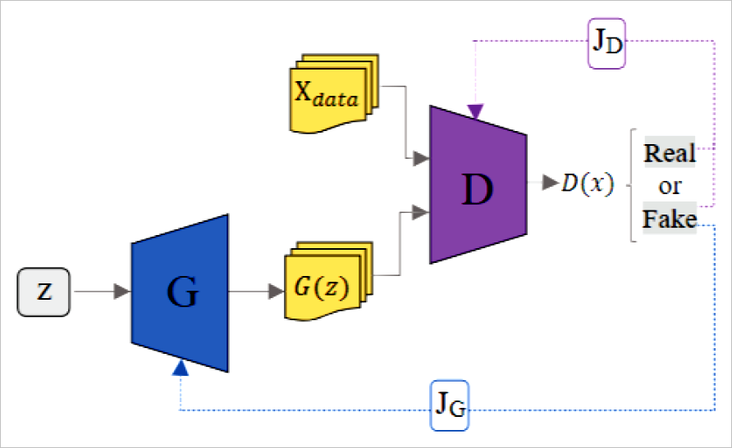
GAN 生成对抗网络
Original image
J_{D}
Real
Samples
X_{data}
Real
Latent
Space
D
D(x)
or
Fake
D
Is D
Correct?
G
G(z)
G
Discriminator
Z
Generated
Fake
Samples
Generator
J_{G}
Fine Tune Training
Noise

Slide 38
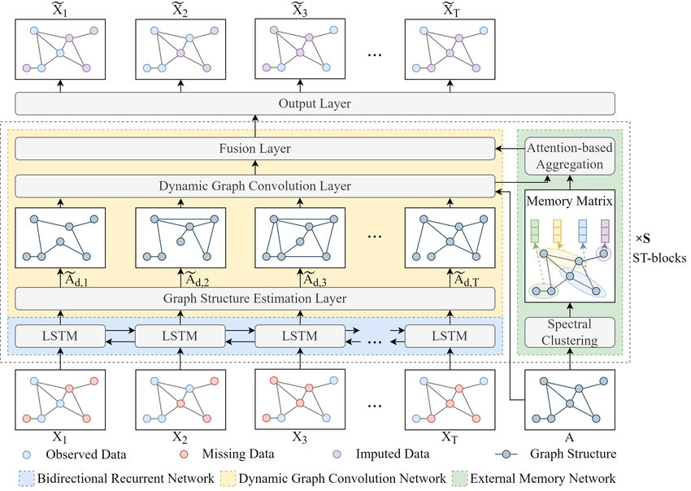
MDGCN
https://www.sciencedirect.com/science/article/abs/pii/S0968090X22002479
Original image
...
Output Layer
Fusion Layer
Attention-based
Aggregation
Dynamic Graph Convolution Layer
Memory Matrix
...
ST-blocks
Graph Structure Estimation Layer
...
Spectral
Clustering
LSTM
LSTM
LSTM
LSTM
...
X₁
X₂
X₃
X_{T}
A
Observed Data
Missing Data
Imputed Data
Graph Structure
Bidirectional Recurrent Network
Dynamic Graph Convolution Network
External Memory Network

Slide 39
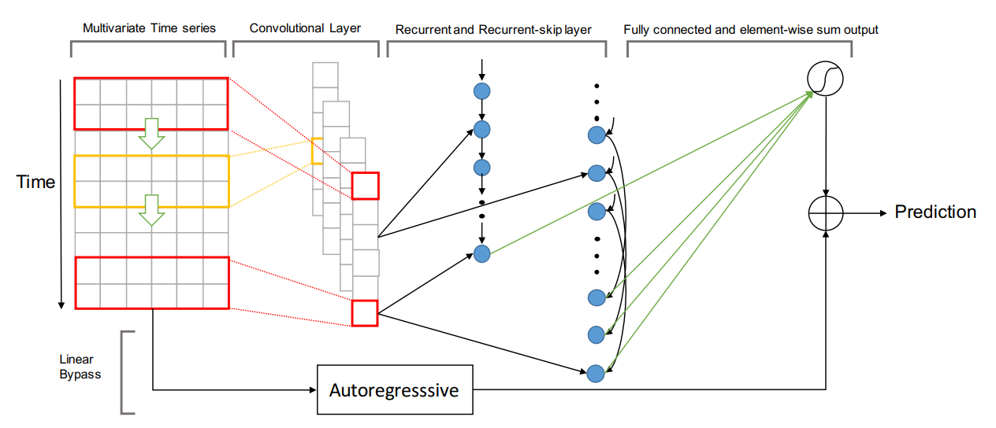
LSTNet 长期和短期时间序列网络
https://arxiv.org/pdf/1703.07015
Original image
Multivariate Time series
Convolutional Layer
Recurrent and Recurrent-skip layer
Fully connected and element-wise sum output
Time
Prediction
Linear
Bypass
Autoregressive

Slide 40
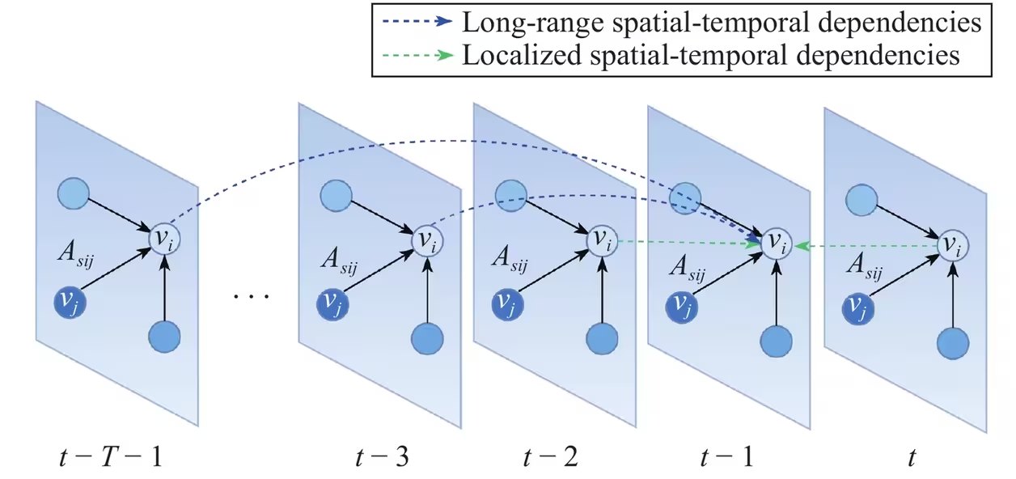
STGSA
https://ieeexplore.ieee.org/document/10007913
Original image
Long-range spatial-temporal dependencies
Localized spatial-temporal dependencies
A_{sij}
v_{i}
A_{sij}
v_{i}
A_{sij}
v_{i}
A_{sij}
v_{i}
A_{sij}
v_{i}
v_{j}
. . .
v_{j}
v_{j}
v_{j}
v_{j}

Slide 41
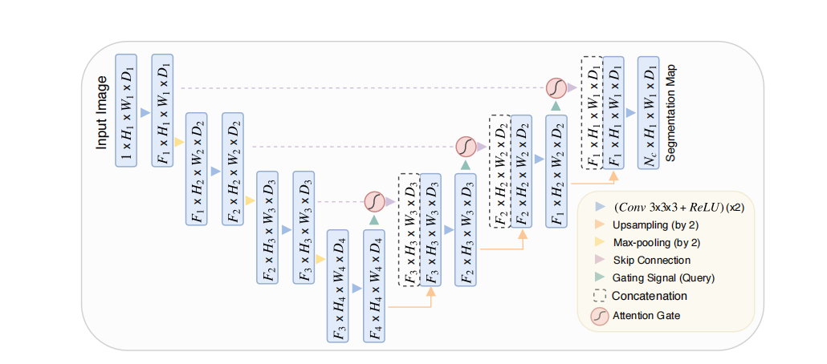
Attention U-Net整体架构
https://arxiv.org/abs/1804.03999
Original image
F₁×H₁×W₁×D₁
F₁×H₁×W₁×D₁
Input Image
F₁×H₁×W₁×D₁
F₁×H₁×W₁×D₁
Segmentation Map
1×H₁×W₁×D₁
F₂×H₂×W₂×D₂
F₁×H₂×W₂×D₂
F₁×H₂×W₂×D₂
F₂×H₂×W₂×D₂
F₂×H₂×W₂×D₂
(Conv 3×3×3+ReLU)(×2)
F₃×H₃×W₃×D₃
F₂×H₃×W₃×D₃
F₂×H₃×W₃×D₃
F₃×H₃×W₃×D₃
F₃×H₃×W₃×D₃
Upsampling(by 2)
Max-pooling(by 2)
Skip Connection
F₃×H₄×W₄×D₄
F₄×H₄×W₄×D₄
Gating Signal(Query)
Concatenation
Attention Gate

Slide 42
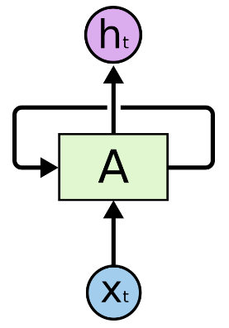
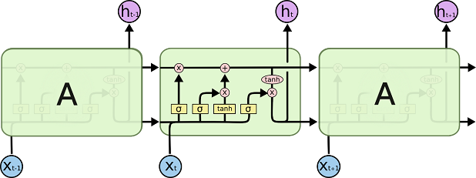
长短期记忆网络LSTM
http://colah.github.io/posts/2015-08-Understanding-LSTMs/
Original image
h_{t}
A
X_{t}
h_{t-1}
h_{t}
h_{t+1}
A
A
X_{t-1}
X_{t}
X_{t+1}

Slide 43
双向LSTM
softmax
Fc
last sequence
concat
concat
concat
concat
LSTM
LSTM
LSTM
LSTM
（1）
LSTM
LSTM
LSTM
LSTM
embedding
x₀
x₁
x₂
x₃
（2）

Slide 44
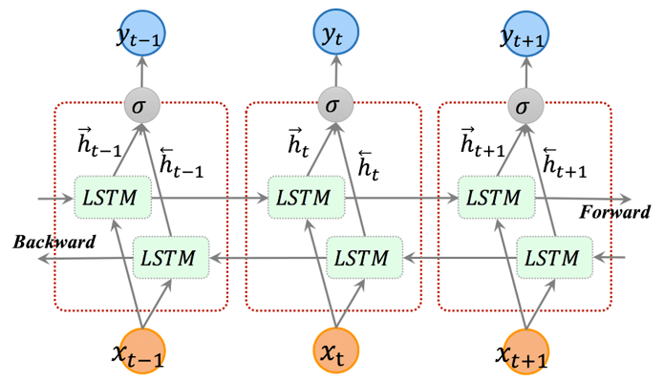
双向LSTM
https://arxiv.org/pdf/1801.02143
Original image
Forward
Bcakward

Slide 45
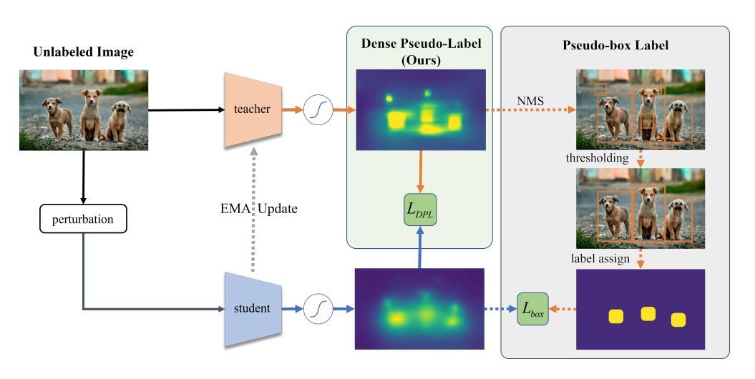
Dense Pseudo-Label
(DPL)
https://arxiv.org/abs/2207.02541
Original image
Dense Pseudo-Label
(Ours)
Pseudo-box Label
Unlabeled Image
NMS
teacher
thresholding
perturbation
EMA Update
label assign
student

Slide 46
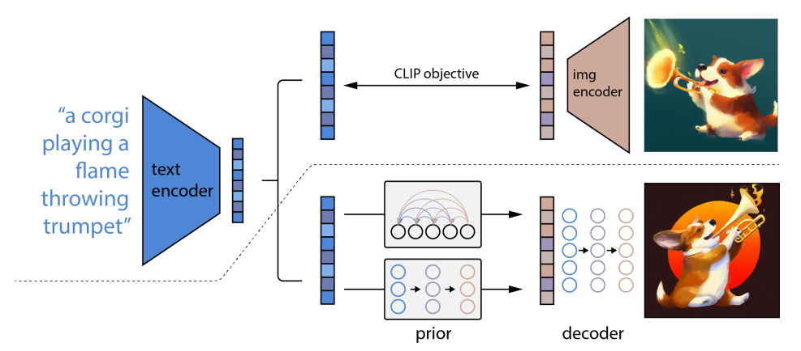
DALL·E 2 模型框架
Original image
CLIP objective
img
encoder
text
encoder
prior
decoder

Slide 47
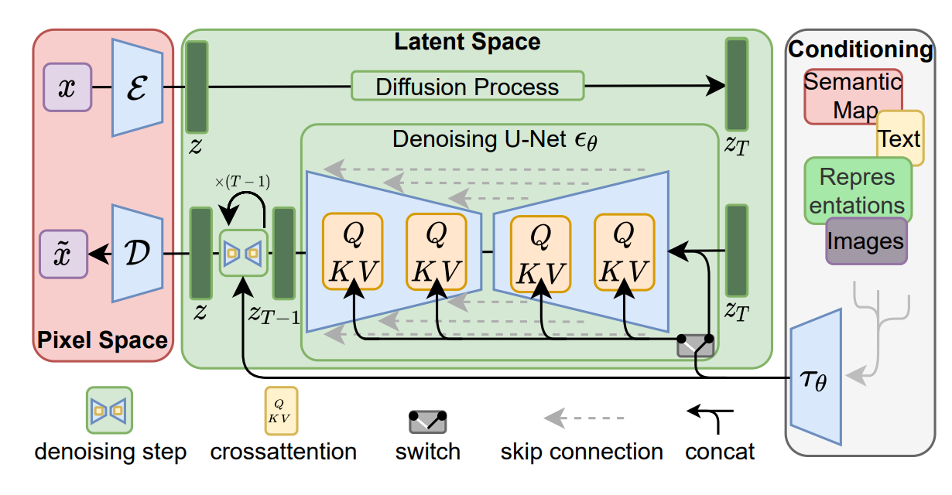
Latent Diffusion Model (LDMs)
https://arxiv.org/abs/2112.10752
Original image
Latent Space
Conditioning
ε
Diffusion Process
Semantic
Map
Denoising U-Net
ϵ_{θ}
Text
𝓩
𝓩
T
Repres
entations
×(T-1)
Q
K V
Q
K V
Q
K V
Q
K V
Images
𝓓
𝓩
𝓩
𝓩
Pixel Space
T-1
T
τ_{θ}

Slide 48
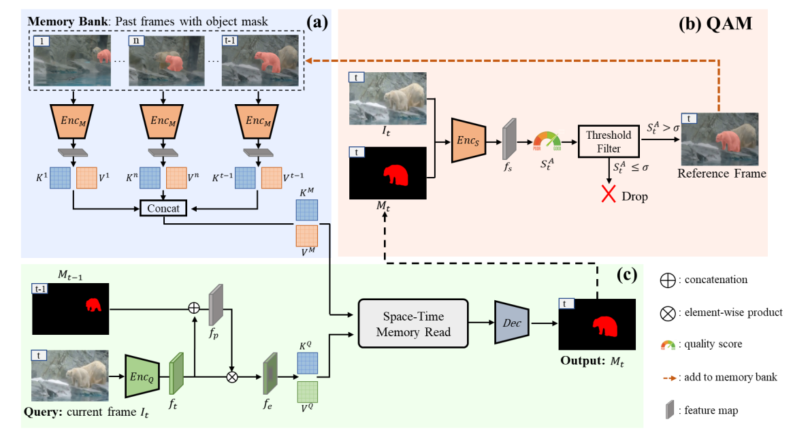
Quality-aware Dynamic M emory Network (QDMN)
https://arxiv.org/abs/2207.07922v1
Original image
Memory Bank: Past frames with object mask
Enc_{M}
Enc_{M}
Enc_{M}
Threshold
Filter
POOR
Good
Reference Frame
Reference Frame
Concat
Space-Time
Memory Read
Dec
Output: M_{t}
Query: current frame I_{t}

Slide 49
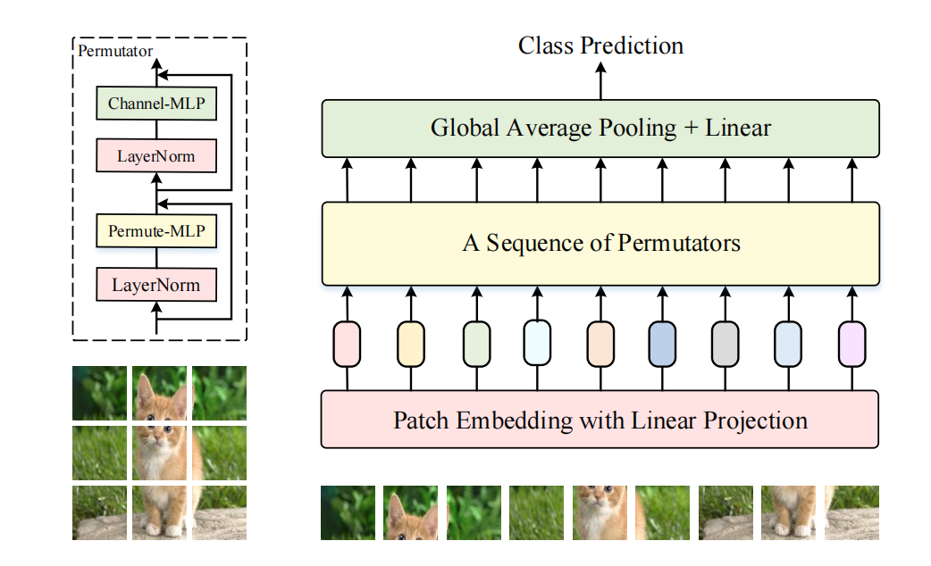
Vision Permutator
https://arxiv.org/abs/2106.12368
Original image
Class Prediction
Permutator
Channel-MLP
Global Average Pooling + Linear
LayerNorm
Permute-MLP
A Sequence of Permutators
LayerNorm
Patch Embedding with Linear Projection

Slide 50
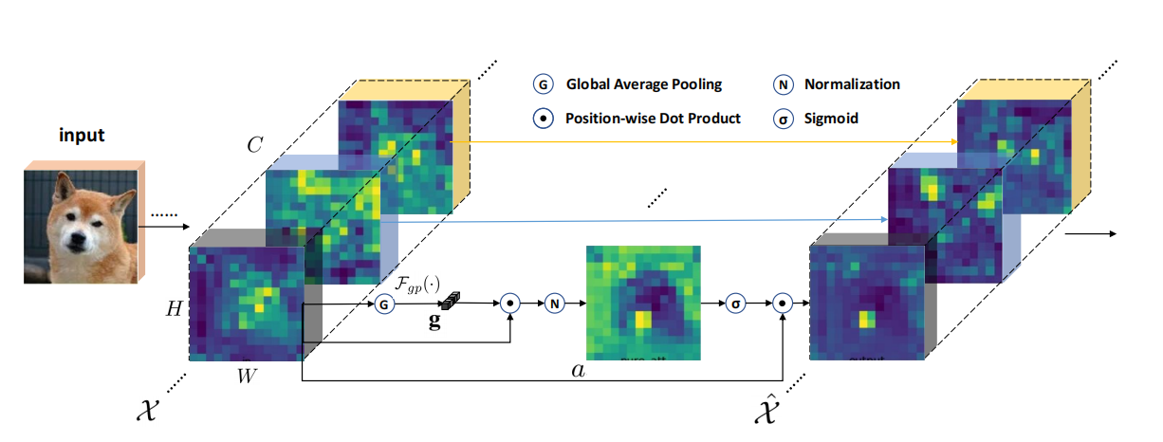
SGE Module
https://arxiv.org/abs/1905.09646
Original image
......
......
Input
C
......
......
H
G
N
σ
g
W
a
......
......
𝓧
^
𝓧

Slide 51
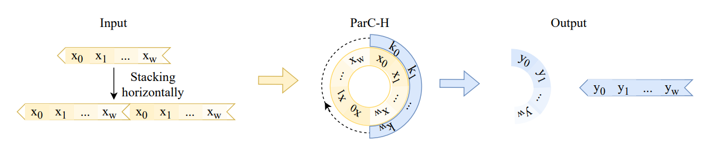
Illustration of global circular convolution on horizontal direction
https://arxiv.org/abs/2203.03952
Original image
Input
ParC-H
Output

Slide 52
杂项1
=
^
=
=

Slide 53




杂项2
Attention

Slide 54
杂项3

